Slide 1
webnote 140
The BIG ideas!
Exchange Rates: summary
I.b Syllabus 3.2: Macroeconomic Objectives: Exchange Rates
Syllabus 34 – 41 (39-41 = HL only)
Webnotes 140 – 150
Notes:
Economies have a natural rate of unemployment- see webnote 316.
How to tackle this rate of unemployment is the issue that divides economists
Demand side or supply side policies?
Is there a trade off between inflation and unemployment? The Phillips curve suggests such a trade off
The Phillips curve appeared to show the impossibility of achieving 2 key government policy objectives simultaneously i.e. policy conflict
Phillips curve works only in short run and will be vertical in long run as shown in diagram A

Slide 2
Market Failure
http://www.yellowsubmariner.com webnote 140
Syllabus reference: items 34 - 41
Market fails to allocate resources efficiently to the the best benefit of society:
Externalities
Monopoly (HL)
Public/merit goods
Asymmetric information
Immobility of factors of production ( poor resource allocation)

Slide 3
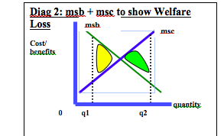
Welfare loss + gain
Webnote 140
See Webnote 149

Slide 4
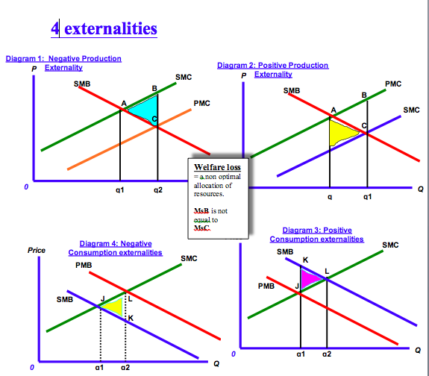
Exchange Rates
http://www.yellowsubmariner.com Webnote 140
Syllabus reference: items 34 -41
See Webnote 143

Slide 5
Diagram analysis
When doing a diagram analysis let the reader know exactly where your analysis starts
In your answer….be sure to indicate where your analysis starts...
This analysis commences at point L (q2) which represents “undercomsumption” because SMB > PMB and therefore represents market failure.

Slide 6
How to draw? Use ‘blue box’
Webnote 140
See Webnote 143

Slide 7
Examples….you need to find some!
Webnote 140
Solutions to market failure: | Do you have an example?
Government intervention | Indirect tax
Government intervention | Tradeable permit scheme. This one is notable because it is a maket based solution. The firm has to buy the permit to pollute i.e. a quota or limit to the level of carbon emissions
Government intervention Government intervention | Smoking ban, or a subsidy to alternative (clean) energy producers International agreement e.g. Kyoto, Paris
Government intervention | Extending property rights e.g. restricting large scale fishing by large factory ships by setting ‘no fishing zones

Slide 8
Supply and Demand for a currency
Webnote 140
See Webnote 144
Evaluate solutions
The problems…
Fossil Fuel Pollution 1,2, 3, 4,6,(8 (clean energy substitutes), 9. Do we want zero pollution? If yes then we tax the polluter but to what extent?
B) Demerit good - tobacco 1,2,4,7
C) University education 1,8
Some solutions
1. Legislation
2. penalties
3. International agreement
4. taxation
5. ban
6. Extending property rights
7.advertising
8. subsidy
9. Tradeable permits

Slide 9
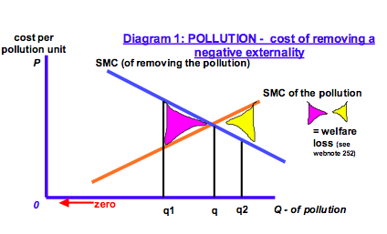
Zero pollution?
Webnote 140
See Webnote 144

Slide 10
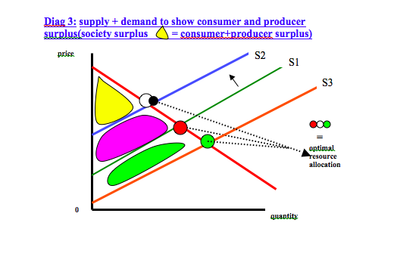
Long run…markets must grow so taxing the polluter must lead to changes in production techinques and a cleaner environment.
Webnote 140
See Webnote 149
See effect of tax on externality on slide 11 q3 moves to q2

Slide 11
Webnote 140
Pollution: solving a negative externality of production using an indirect rax
smc
smb=pmb
Costs+benefits
mpc +tax
R
S
mpc
P3
z
P2
Indirect Tax reduces welfare loss from srx to tzx (remove triangles)
t
P1
x
q1
q2
q3
Quantity of good A

Slide 12
Webnote 140
Pollution: solving a negative externality of production using an indirect rax
smc
smb=pmb
Costs+benefits
mpc +tax
R
S
mpc
P3
z
P2
Indirect Tax reduces welfare loss from srx to tzx (remove triangles or see slide 13)
t
P1
x
q1
q2
q3
Quantity of good A

Slide 13
Webnote 140
Pollution: solving a positive externality of production using a subsidy
pmc
Costs+benefits
smb=pmb
pmc + subsidy
S
smc
P3
t
Subsidy reduces welfare loss from srx to tzx and quantity increases to q2
P2
P1
x
z
R
q1
q2
q3
Quantity of good A

Slide 14
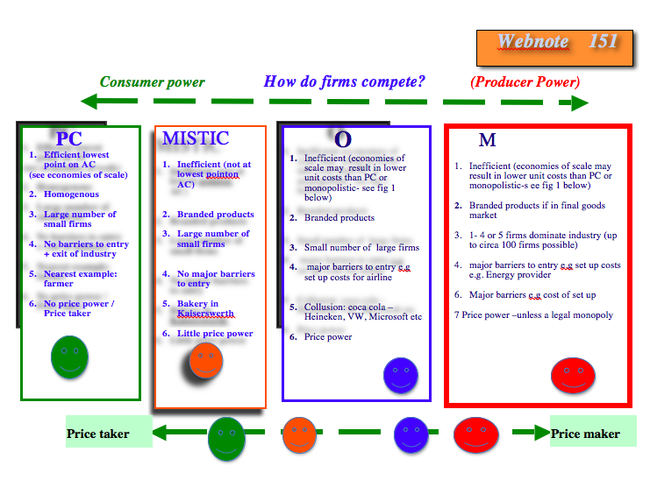
Monopoly Power…HL only
Webnote 140
See Webnote 146

Slide 15
The Exam question…IBQ
Webnote 140
See Webnote 145
May 2014 syllabus 1.2 HL
1a) Analyse the private and external benefits associated with the consumption of university education. (10 marks)
1b) Evaluate the policies a government might use to increase the consumption of university education.(15 marks)

Slide 16
http://www.yellowsubmariner.com
Webnote 140
Reading:
See Blink pp 139-154
AAA
But more importantly….
Your dictionary +
Your notes
End

