Slide 1
Deadweight Loss
After indirect taxation

Slide 2
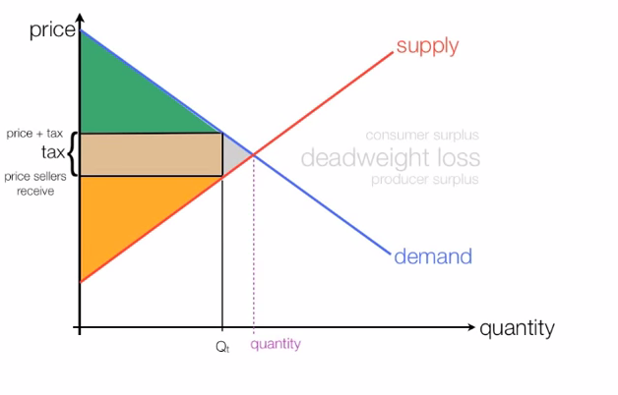
Deadweight Loss
Deadweight Loss = cost to society due to reduction in market size as a result of some intervention (indirect taxation in this instance)

Slide 3
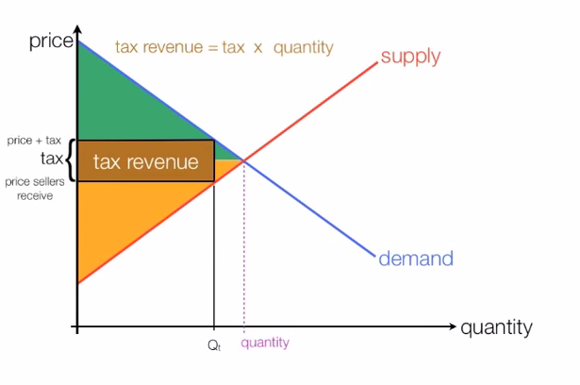
Deadweight Loss

Slide 4
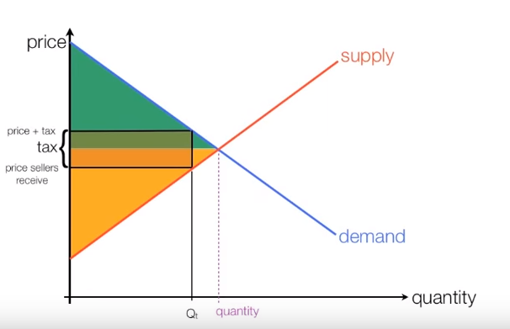
Deadweight Loss

Slide 5
Deadweight Loss
falls
falls

Slide 6
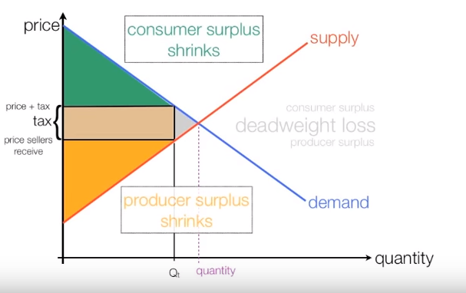
Deadweight Loss
Outcome: markets get smaller due to indirect taxation (gray triangle or quantity reduction on X axis. Governments must understand this as a consequence of intervention i.e. markets shrink as a result of taxation

